Slide 1
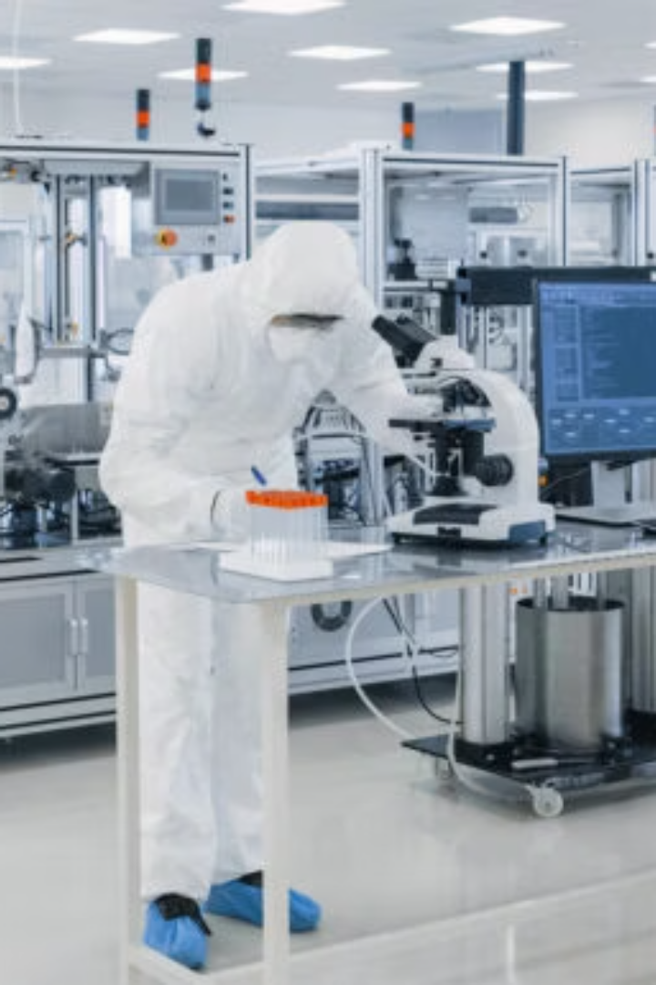

Corporate Profile

Slide 2

Who we are
Our team specializes in Vaccines, Biologicals and Pharmaceuticals business development with a strong focus on strategic alliances and partnerships.
The company's core team, comprised of seasoned international Business Development and International General Management Experts, brings extensive expertise ensures effective Business Development Solutions to support Portfolio Development as well as effective market expansion strategies
By leveraging collaborations with multinational and local partners, DVS delivers significant value, enabling the commercialization of prioritized products in the international arena, as well as the development of its clients and partners portfolio.

Slide 3


Collaborations, Growth Engines – Vaccines
DVS is actively building a strong vaccines Business development and access platform through strategic collaborations and regional expansion
A LEADING BIOTECHNOLOGY COMPANY IN BRAZIL
A NETWORK OF LEADING SDISTRIBUTION COMPANIES
A EUROPEAN VACCINE COMPANY
VACCINES INDUSTRIAL COMPANY VIC – SAUDI ARABIA:
Vaccine Company - IBRAZIL:
REGIONAL DISTRIBUTION NETWORK (MENA AND BEYOND):
(COVID-19 RESPONSE):
DVS IS PARTNERING WITH VIC TO SUPPORT TECHNOLOGY TRANSFER PROJECTS INTO THE KINGDOM OF SAUDI ARABIA AND TO COLLABORATE WITH NATIONAL AUTHORITIES IN SECURING SUPPLY OF KEY VACCINES FOR THE PUBLIC MARKET. DVS ALSO ACTS AS VIC’S COMMERCIAL AGENT ACROSS THE MENA REGION.
DVS SUPPORTS A LEADING PUBLIC VACCINE INSTITUTE IN LATIN AMERICA IN EXPANDING THE INTERNATIONAL REACH OF ITS INFLUENZA VACCINES, BEYOND LATAM, WITH POTENTIAL TO EXTEND THE COLLABORATION TO OTHER VACCINE PRODUCTS.
DVS IS BUILDING A ROBUST NETWORK OF DISTRIBUTORS IN KEY MENA COUNTRIES TO COMMERCIALIZE LEADING VACCINE PORTFOLIOS, WITH PLANS TO SCALE INTO ADDITIONAL REGIONS.
DURING THE COVID-19 PANDEMIC, DVS WAS APPOINTED BY A GLOBAL VACCINE DEVELOPER TO MANAGE THE COMMERCIAL DEVELOPMENT OF ITS VACCINE ACROSS OVER 30 COUNTRIES IN LATAM, MEA, AND APAC, DEMONSTRATING DVS’S CAPACITY TO DRIVE LARGE-SCALE INTERNATIONAL VACCINE MARKET ACCESS.

Slide 4



Collaborations, Growth Engines – Biologicals & Pharmaceuticals
DVS is expanding its footprint in the pharmaceutical space through high-value partnerships and strategic regional operations:
A LEADING BIOTECHNOLOGY AND PHARMACEUTICAL COMPANY IN ARGENTINA:
A LEADING PHARMACEUTICAL AND HEALTHCARE GROUP – BELGIUM:
mediserve
MedServe (Kinshasa & Dubai): Through a joint venture, DVS and MediServe, , a Leading DRC Distribution company collaborate to supply branded pharmaceutical products across THE DRC. DVS manages product sourcing and registration; MedServe handles importation, logistics, sales, and distribution—ensuring reliable supply to patients.
DVS ACTS AS THE COMPANY’S COMMERCIAL PARTNER TO EXPAND ITS RESPIRATORY, DERMATOLOGY, AND BIOLOGICALS PORTFOLIO INTO NEW INTERNATIONAL MARKETS. IN PARALLEL, DVS SUPPORTS THE COMPANY IN THE DEVELOPMENT OF ITS VACCINES PORTFOLIO FOR THE ARGENTINIAN AND BROADER LATAM REGION.
MEDIS (B2B DIVISION OF A LEADING EUROPEAN PHARMACEUTICAL GROUP): DVS FACILITATES B2B CONTRACTS BETWEEN MEDIS AND INDUSTRIAL CLIENTS, SUPPORTING THE OUT-LICENSING AND SUPPLY OF AN E-CTD WIDE PORTFOLIO OF PHARMACEUTICAL AND BIOLOGICALPRODUCTS.
DVS IS THE OFFICIAL AGENT IN THE DRC FOR THIS GROUP, WHICH SUPPLIES A BROAD PORTFOLIO OF PHARMACEUTICAL AND MEDICAL PRODUCTS TO THE PUBLIC SECTOR, REINFORCING DVS’S POSITION IN PUBLIC HEALTH PROCUREMENT AND LOGISTICS.

Slide 5

simple Business Model
DVS offers a robust value proposition to principals and partners, emphasizing the development of business solutions, strategic planning, alliances and partnerships across multiple markets with a single contract. By fostering strategic collaborations with institutions, private companies and in certain cases with Governments, DVS ensures growth aligned with agreed business objectives, driving impactful business development and commercial strategies.
DVS operates as business partners, with a business model based on retainer, success fees and commissions, dedicated to developing together the international footprint and portfolio of small to mid-size companies in the healthcare sector.

Slide 6
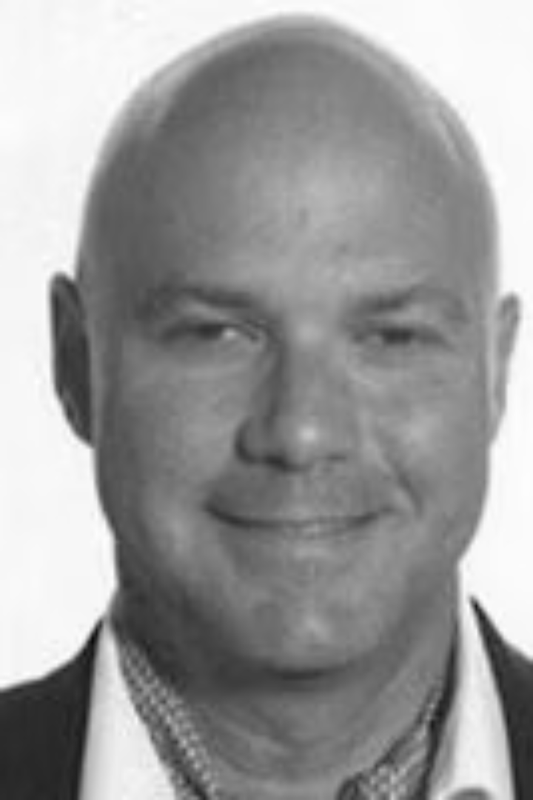
Doronn Victor Sitruk
Co-Founder, Partner Commercial Strategy & Market Access
a seasoned Business Development professional with over 30 years of international experience in the healthcare industry, including Vaccines and Pharmaceuticals sectors, having worked for prominent companies such as GSK, Novo Nordisk, Eli Lilly, Schering-Plough, and Teva. His career spans across Europe, the USA, and the International regions, with a specialized focus on business development, commercial strategy and Market Access
At GSK, Doronn served as the Vaccines International Franchise Head, overseeing influenza, travel vaccines, adult and adolescent vaccines. The scope included MENA LATAM CANADA and ASIA. Before that, he led Commercial Strategy in China and supported selected markets in APAC, including Hong Kong, Taiwan, and South Korea, on numerous strategic projects.
Doronn has a notable track record of establishing successful international joint ventures and alliances, resulting in sustainable, win-win value creation. He has implemented balanced strategies and effective portfolio and supply chain systems in various international markets, especially in the Middle East and Africa.
Since 2016, Doronn has been the CO-founder of DVS partners, leveraging his extensive industry knowledge to drive impactful business development and commercial strategies in the healthcare sector.

Slide 7
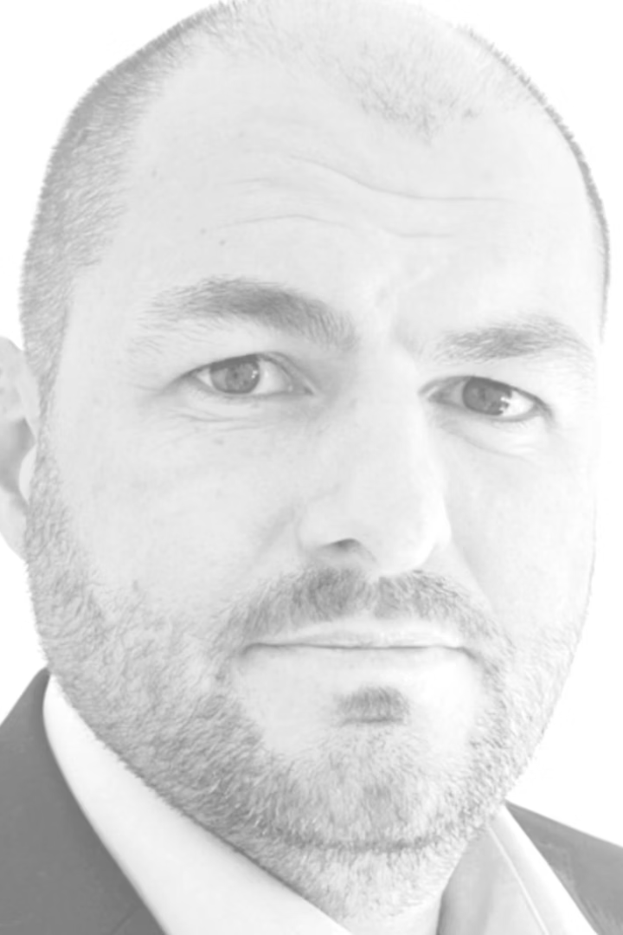
Damien Dessis
Co-Founder, Partner Business Development & Licensing
Damien Dessis is an experienced business development leader in the biologics and vaccines sectors, with a strong track record across global markets. Over the course of his career, he has developed broad expertise in deal structuring, financial valuation, negotiation, and complex partnering transactions, helping organizations build value through strategic collaborations and portfolio growth.
Damien has held senior business development roles, namely at GSK Vaccines, Valneva and various smaller organizations, where he contributed to advancing innovative vaccines and biologics portfolios through partnerships, licensing agreements, and pipeline optimization initiatives. His strategic vision and keen understanding of industry trends have allowed him to forge successful partnerships and transactions, creating significant value and growth for his organizations.
With more than 20 years in the biotech and pharmaceutical industries, Damien has worked closely with both established companies and emerging start-ups, supporting them in areas such as business modeling, strategic planning, and fundraising. Known for his pragmatic collaborative approach and analytical mindset, he combines scientific understanding with business acumen to identify and develop new opportunities that drive sustainable growth.

Slide 8
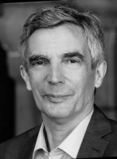
Dr Dirk Poelaert
Partner, Chief Medical Officer
Dr. Dirk Poelaert is a senior medical leader and global expert in vaccines and pharmaceuticals, with more than 30 years of international experience across medical, clinical, and commercial operations in leading global companies. A medical doctor by training (KU Leuven) with postgraduate studies in Business Management and Clinical Trials & Statistics, he has held senior leadership positions at Eli Lilly, Astra, MSD Belgium, and GSK Vaccines, where he directed European and global medical affairs, clinical operations, and vaccine-strategy programs. His career reflects a strong balance between scientific excellence, operational rigor, and strategic vision, consistently driving innovation, compliance, and value creation across the healthcare ecosystem.
Dr. Poelaert’s expertise spans the full vaccine lifecycle, with a unique focus on pandemic preparedness and response, including influenza and COVID-19 vaccines. At GSK Biologicals, he served as Global Medical Director for Pandemic Influenza, leading scientific communication and global medical planning during critical health-emergency phases. His deep understanding of vaccine R&D, medical affairs, and public-health interfaces positions him as a recognized authority in pandemic-vaccine strategy and implementation.
Dr. Poelaert recently joined DVS Partners as Partner and Chief Medical Officer, bringing his extensive expertise in vaccines, biologics, and biosimilars to strengthen DVS’s scientific leadership and global development strategy.

Slide 9
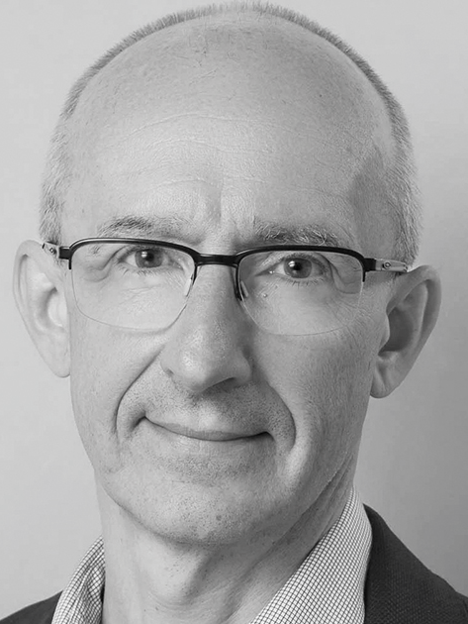
Dr Laurent Massuyeau
Advisor, Biosimilars
Dr. Laurent Massuyeau is a global expert in biosimilars and biologics commercialisation, combining deep scientific knowledge with extensive executive experience. A Doctor of Veterinary Medicine with an MBA from INSEAD, he began his career in senior roles at Eli Lilly, Novartis, and Merck Serono, where he led international business development and licensing activities. In 2013, he founded IQone Healthcare Europe, a Swiss-based specialty and biosimilar company dedicated to improving patient access to high-quality biologics across Europe.
Under his leadership, IQone Healthcare Switzerland became one of the top three biosimilar companies in the Swiss market, renowned for operational excellence and trusted partnerships with leading global biopharma players. IQone Europe was acquired by Clinigen Group in 2018, becoming Clinigen Europe, and IQone Switzerland was acquired by Celltrion in 2024, becoming its Swiss subsidiary.
Dr. Massuyeau now serves as a Senior Advisor and member of the DVS Partners Advisory Board, where his experience in biosimilar strategy, market access, and cross-border partnerships supports the international expansion of sustainable biologics initiatives

Slide 10
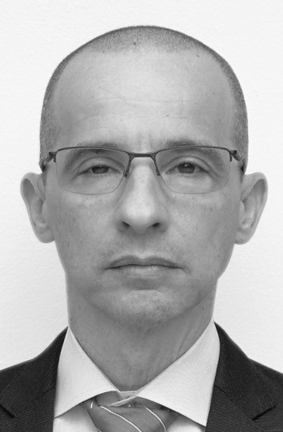
Guy Dotan
Partner, Licensing, Biosimilars
Guy spent more than 18 years at Teva Pharmaceuticals, where he was a senior member of the Global Business Development & Licensing team. In this capacity, he personally led negotiations for dozens of high-value licensing deals and strategic alliances, managing multi-functional teams and aligning with key internal stakeholders in R&D, legal, regulatory, and commercial operations.
Following his tenure at Teva, Guy served as Head of Business Development at Trevena, a publicly traded US biotech company. There, he led the global out-licensing strategy for Trevena’s lead asset, Olinvyk®, and drove alliance management initiatives with regional and global partners. He was also actively involved in partnering discussions for the company’s early-stage pipeline assets.
In 2023, Guy joined DVS Pharmaceuticals as Partner, where he leverages his deep licensing experience, commercial acumen, and global network of contacts to advise biotech and pharma companies on strategic growth opportunities. His core focus includes licensing strategy, transaction execution, commercial deal structuring, and strategic entry into key international markets. Guy is known for his pragmatic, value-driven approach to business development and his ability to bridge science, strategy, and execution.

Slide 12



